Slide 1
Building Classification Models
Train Binary Classification Models
Train Multi-Class Classification Models
Evaluate Classification Models
Tune Classification Models

Slide 2

Train Binary Classification Models

Slide 3
Linear Regression Shortcomings (Slide 1 of 2)
Data example
Line of best fit
1 (Yes)
Threshold (0.50)
Heart disease?
0 (No)
Cholesterol

Slide 4
Linear Regression Shortcomings (Slide 2 of 2)
Data example
Examples now negative
Line of best fit
1 (Yes)
Threshold (0.50)
Outlier
Heart disease?
0 (No)
Cholesterol

Slide 5
Logistic Regression
Data example
Line of best fit
1 (Yes)
Heart disease?
0 (No)
Cholesterol

Slide 6



Logistic Function
Logistic function—A type of sigmoid function used in logistic regression.
Where:
t is the prediction between negative infinity and positive infinity.
e is the natural logarithm base.
t is essentially the linear model with multiple parameters formula:
Objective is to estimate θ model parameters.
$$σ(t)=\frac{1}{1+e^{−t}}$$
$$σ(t)=\frac{1}{1+e^{−t}}$$
$$\hat{y}=θ_{0}+\sum_{i=1}^{d}{θ_{i}x_{i}}$$

Slide 7
Decision Boundary
Data example
Line of best fit
1 (Yes)
Heart disease?
Decision boundary (0.50)
0 (No)
Cholesterol

Slide 8

Cost Function for Logistic Regression
You can't use MSE for logistic regression.
Would result in non-convex function with multiple local minima.
As prediction t approaches 0, −log(t) increases significantly if observed classification (y) is in the positive class (1).
If y is in negative class (0), −log(t) increases significantly as t approaches 1.
Applied to whole training set as average of cost of all training examples (log loss).
Normal equation cannot minimize logistic regression; gradient descent can.
Cost function for logistic regression, where:
y is the observed classification
c(θ) is the cost function.
p̂ is the predicted probability
$$if y=1, c\left(θ\right)=−\log\left(\hat{p}\right)$$
$$if y=0, c\left(θ\right)=−\log\left(1−\hat{p}\right)$$

Slide 9
A Simpler Alternative for Classification (Slide 1 of 2)
Class 0
Class 1
Vehicle Size
Vehicle Weight

Slide 10
A Simpler Alternative for Classification (Slide 2 of 2)
Class 0
Class 1
Example
Vehicle Size
Test example
Vehicle Weight

Slide 11
k-Nearest Neighbor (k-NN)
$$k=3$$
Class 0
Class 1
Example
Vehicle Size
Class 0 wins vote
Vehicle Weight

Slide 12
k Determination
$$k=5$$
Class 0
Class 1
Example
Vehicle Size
Class 1 wins vote
Vehicle Weight

Slide 13
Logistic Regression vs. k-NN
Both are used to solve classification problems.
k-NN doesn't really train a model.
Its classification skill doesn't improve through learning.
It calculates the distance between examples and determines the class.
Output from k-NN is a classification, not a probability.
Simpler to implement than logistic regression.
k-NN can take a very long time to make a prediction.
Especially with large datasets.
Logistic regression is typically much faster when making predictions.
Summary:
k-NN for simplicity and when working with small datasets.
Logistic regression when working with large datasets and predictions are needed quickly.

Slide 14

Train a Binary Classification Model
Consider using logistic regression rather than linear regression for classification.
In k-NN, consider how lower/higher k values change boundaries/noise sensitivity.
Consider making k odd for binary classification.
Consider using a bootstrapping approach to selecting k.
Consider using cross-validation to help select k.
Consider using k-NN when simplicity is key and the dataset is small.
Consider using logistic regression when predictions must be quick and the dataset is large.
Time permitting, try both and examine the results.

Slide 15
Use Python for Binary Classification
Use scikit-learn's LogisticRegression() class to build a binary classifier:
model = sklearn.linear_model.LogisticRegression(penalty = 'l2', C = 0.05, solver = 'sag')
model.fit(X_train, y_train)
model.score(X_test, y_test)
model.predict(X_test)
model.predict_proba(X_test)
model.coef_
Use scikit-learn's KNeighborsClassifier() to build an alternative binary classifier:
model = sklearn.neighbors.KNeighborsClassifier(n_neighbors = 3)
Use same methods as with LogisticRegression()

Slide 16
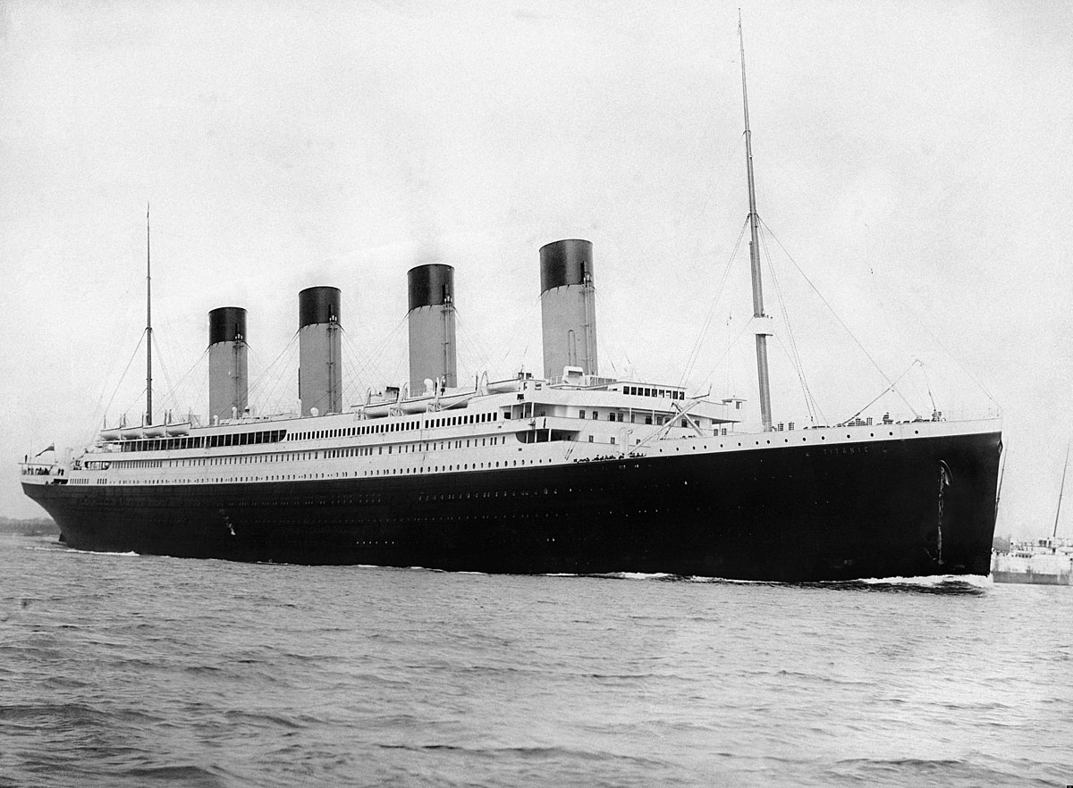
Activity: Training Binary Classification Models
You work for the History department of a state college.
An upcoming lecture is on the sinking of the RMS Titanic.
Department wants to teach students how various factors affected passenger survival.
Rather than lecture directly, you want students to reach their own conclusions.
You want their experience to be hands-on.
You'll build a machine learning model for students.
You have a real-world dataset of Titanic passengers.
Each passenger is labeled as having survived or perished.
Students can use this to see if they would have survived given their own features.

Slide 17

Activity: (Optional) Creating a Logistic Regression Model to Predict Breast Cancer Recurrence
Women with breast cancer are at risk of recurrence.
GCPG wants to know who is most likely at risk.
Will help them prioritize care.
You have a dataset of patients with breast cancer.
You'll use a logistic regression model to classify the patient as either at risk or not at risk of recurrence.

Slide 18
Train Multi-Class Classification Models

Slide 19
Multi-Label Classification
Multi-Label Classification: A classification scheme in which a data example is given more than one label.
As opposed to binary classification, in which an example is x or is not x.
Classifying nouns in a sentence.
Category 1: Noun is either a subject or object.
Category 2: Noun is either proper or common.
Classes in each category are mutually exclusive.
All nouns are either subjects or objects.
All nouns are either proper or common.
Classes between categories are not mutually exclusive.
Noun can be: proper subject, common subject, proper object, or common object.
Multi-label problems can be solved by training multiple binary classifiers.
Unless labels are correlated.
In noun example, train one model for category 1, then another model for category 2.

Slide 20
Multi-Class Classification
Multi-Class Classification: A classification scheme in which a data example is placed within a single class among three or more choices.
Classes are mutually exclusive.
Example cannot belong to class A and B and C.
Example must belong to A or B or C.
Classifying words based on how they're used in a sentence:
Noun
Verb
Adjective
Etc.
A word is either a noun or some other non-noun type; it cannot be both.
Such problems require a unique approach.

Slide 21


Multinomial Logistic Regression
Multinomial Logistic Regression: A method for solving multi-class classification problems.
Softmax function determines class with highest probability.
In the sentence "I saw the movie yesterday," the probabilities for "saw" are:
84% verb
13% noun
3% adjective
Multinomial logistic regression starts by computing a score, where:
k is the class.
θ is the vector of model parameters.
x is the vector of feature values.
$${\left(x\right)}_{k}={\left(θ^{\left(k\right)}\right)}^{T}∙x$$
Scores are computed for every class, then plugged into the softmax function, where:
σ(x)_{k} is the probability that example x belongs to class k given the earlier score.
K is the total number of classes.
$$σ{\left(x\right)}_{k}=\frac{exp{\left(x\right)}_{k}}{\sum_{j=1}^{K}{exp{\left(x\right)}_{j}}}$$

Slide 22
Train a Multi-Class Classification Model
Consider how a multi-label classification approach may be required.
For multi-label problems, consider training multiply binary classifiers.
Consider how a multi-class classification approach may be required.
For multi-class problems, consider training a multinomial logistic regression model.

Slide 23
Use Python for Multi-Class Classification
Use scikit-learn's LogisticRegression() class to build a multi-class classifier:
model = sklearn.linear_model.LogisticRegression(multi_class = 'multinomial')
Use same methods/attributes as before.

Slide 24

Activity: Training a Multi-Class Classification Model
Other professors at the college want to apply machine learning to their fields.
Chemistry department wants to help students learn about chemical interactions.
Slight variations in substance's chemical makeup can change its form.
You've been given a dataset of wines.
Each wine is classified according to cultivar.
There are three classes, not just two.
You need to build a multi-class classification model.

Slide 25
Evaluate Classification Models

Slide 26
Model Performance
As you train a classifier, there are several ways the model can succeed or fail.
True Label | Predicted Label | Result | Assessment
Yes | Yes | Success | True positive (TP)
No | No | Success | True negative (TN)
No | Yes | Failure | False positive (FP)
Yes | No | Failure | False negative (FN)

Slide 27
Confusion Matrix
 |  | Actual
 |  | Yes | No
Prediction | Yes | True positives | False positives
 | No | False negatives | True negatives
 |  | Actual
 |  | Heart disease | No heart disease
Prediction | Heart disease | 43 | 6
 | No heart disease | 3 | 212

Slide 28
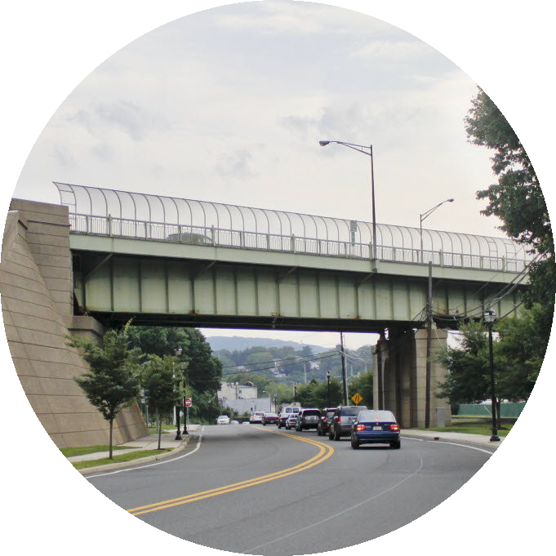
Classifier Performance Measurement
You must evaluate a classifier's performance.
Every prediction being correct is infeasible; the model will make some mistakes.
You must tune the model to ensure that it makes correct predictions when essential, at the expense of allowing failures within what is tolerable.
Bridge camera inspection example:
Positive = Bridge labeled as defective.
False negatives:
Problematic. May lead to defective bridges going unchecked.
False positives:
Not a problem. Just means that some bridges still in acceptable condition will be examined for defects.
In this case, it is better to err on the side of overidentifying.

Slide 29

Accuracy (Slide 1 of 2)
True Positives
+ True Negatives
Correct predictions
True Positives
+ True Negatives
+ False Positives
+ False Negatives
All predictions
$$\frac{TP+TN}{TP+TN+FP+FN}$$

Slide 30
Accuracy (Slide 2 of 2)
 |  | Actual
 |  | Collapse | No collapse
Prediction | Collapse | 1 | 1
 | No collapse | 2 | 512

Slide 31

Precision
True Positives
Correct positive predictions
True Positives
+ False Positives
All positive instances
$$\frac{TP}{TP+FP}$$

Slide 32

Recall
True Positives
Correct positive predictions
True Positives
+ False Negatives
All relevant instances
$$\frac{TP}{TP+FN}$$

Slide 33
Precision–Recall Tradeoff
High precision, low recall
1.0
Precision
Low precision, high recall
0.0
0.0
1.0
Recall

Slide 34


F₁ Score
Precision and recall are more useful in unbalanced datasets.
They come with a tradeoff.
Not always clear which metric is more useful.
A false positive may be just as undesirable as a false negative.
F₁ score helps you find optimal combination of both precision and recall.
$$F_{1}=2\left(\frac{precision∙recall}{precision+recall}\right)$$
$$F_{1}=2\left(\frac{.91∙.81}{.91+.81}\right)$$
Resulting F₁ score is around 86%.

Slide 35
Receiver Operating Characteristic (ROC) Curve
1.0
Model A
Model B
Random guess
True Positive Rate
0.0
0.0
1.0
False Positive Rate

Slide 36


Thresholds (Slide 1 of 2)
Actual negative
Actual positive
False positive
False negative
0.0
1.0
Prediction Probability

Slide 37
Thresholds (Slide 2 of 2)
Actual negative
Actual positive
True negative
False negative
0.0
1.0
Prediction Probability

Slide 38
Area Under Curve (AUC)
1.0
AUC = 0.88
True Positive Rate
0.0
0.0
1.0
False Positive Rate

Slide 39
Precision–Recall Curve (PRC)
1.0
Model
No-Skill Line
Precision
0.0
0.0
1.0
Recall

Slide 40
Evaluate a Classification Model
Consider the significance of TPs, TNs, FPs, and FNs.
Use a confusion matrix to visualize truth results.
Consider that accuracy may not be useful in imbalanced datasets.
Prefer precision and recall when dataset has a class imbalance.
Consider that recall may be better than precision when minimizing FNs is important.
Consider the precision–recall tradeoff.
Use F₁ score when neither precision nor recall are more important.
Generate a ROC curve and its AUC to compare TPR and FPR for all thresholds.
Prefer a PRC to ROC curve when dataset has a class imbalance.
Use average precision to summarize PRC.
Consider there is no objectively "correct" metric for a problem.
Consider applying multiple metrics to the same problem.

Slide 41
Use Python to Evaluate a Classifier
Use scikit-learn's metrics module to evaluate a classifier:
sklearn.metrics.confusion_matrix(y_test, prediction)
sklearn.metrics.accuracy_score(y_test, prediction)
sklearn.metrics.precision_score(y_test, prediction)
sklearn.metrics.recall_score(y_test, prediction)
sklearn.metrics.f1_score(y_test, prediction)
sklearn.metrics.roc_curve(y_test, prediction_proba)
sklearn.metrics.roc_auc_score(y_test, prediction_proba)
sklearn.metrics.precision_recall_curve(y_test, prediction_proba)
sklearn.metrics.average_precision_score(y_test, prediction_proba)

Slide 42
Activity: Evaluating a Classification Model
Your Titanic classifier has room for improvement.
You want it to make good predictions, not just any predictions.
To eventually improve the model's skill, you'll evaluate its performance in several ways.

Slide 43
TunE Classification Models

Slide 44
Hyperparameter Optimization
Hyperparameter Optimization: The process of repeatedly altering hyperparameters that an algorithm uses to train a model to determine the hyperparameters that lead to the best or desired level of model performance.
You can try tuning the hyperparameters manually.
This can get tedious and is prone to error.
Automated optimization methods:
Grid search
Randomized search
Bayesian optimization
Genetic algorithm

Slide 45
Grid Search
Grid Search: A hyperparameter optimization method that takes a grid of parameter combinations, trains a model using each one, then returns the best combination that optimizes an evaluation metric.
You supply which metric you want to optimize on.
Can also use cross-validation to derive parameters by training over several folds.
Example parameter grid:
grid = [{'solver': ['liblinear'],
'penalty': ['l1', 'l2'],
'C': [0.01, 0.1, 1, 5, 10, 100]}]
Each is a separate hyperparameter.
Will train on dataset 1 × 2 × 6 = 12 times.
Example search object:
search = GridSearchCV(model, param_grid = grid, scoring = 'f1', cv = 5)
Will do 5-fold cross-validation for each combination.
Trains 12 × 5 = 60 times.
Optimizes on F₁ score.

Slide 46
Randomized Search
Randomized Search: A hyperparameter optimization method that uses random combinations of hyperparameters to train and evaluate a model.
Takes a distribution of algorithm combinations, rather than a grid.
Algorithm selects values from these distributions for a certain number of iterations.
Example parameter grid:
dist = {'solver': ['liblinear'],
'penalty': ['l1', 'l2'],
'C': sp_randint(1, 100)}
search = RandomizedSearchCV(model, param_distributions = dist, n_iter = 50, scoring = 'f1', cv = 5)
C is now a distribution of random integers from 1 to 100.
n_iter specifies number of times a random combination is sampled.
Also performs cross-validation.
Can minimize training time in large feature spaces.
Not as thorough as grid search, but will usually lead to adequate results.

Slide 47
Bayesian Optimization
Bayesian Optimization: A hyperparameter optimization method that uses past samples to influence where sampling is conducted in subsequent iterations.
Can determine the next optimal space to sample from.
Makes it "smarter" than randomized search.
Can get to optimal hyperparameters much faster.
Simplified process:
Start with initial random sampling of distribution space.
Evaluate loss function for this space.
Use evaluation to compute a posterior distribution of the loss function.
Sample new space that optimizes acquisition function.
Evaluate loss from new space.
Repeat steps 3 through 5 until some stopping criterion is met.
More complicated and harder to implement than randomized search.
Has shown to be faster in some scenarios, however.

Slide 48

Genetic Algorithms
First Generation
Crossover
Mutation
Second Generation
Killed

Slide 49
Tune a Classification Model
Use a grid/randomized search to find optimal hyperparameters for a model.
Perform search based on a chosen metric.
Define a grid containing the hyperparameters to search through.
Prefer randomized search when time is an issue.
Adjust number of iterations in randomized search to account for time.
Consider Bayesian optimization may be faster than randomized search, but is more complicated.
Consider genetic algorithms are typically not as useful as other methods.
Use optimization for other types of problems, not just classification.

Slide 50
Use Python to Tune a Classifier
Use scikit-learn's GridSearchCV() and RandomizedSearchCV() to determine optimal hyperparameters while also performing cross-validation:
search = sklearn.model_selection.GridSearchCV(model, param_grid = grid, scoring = 'recall', cv = 5)
search = sklearn.model_selection.RandomizedSearchCV(model, param_distributions = dist, n_iter = 100, scoring = 'recall', cv = 5)
Use same methods and metrics as before.
Returns values based on model with optimal hyperparameters (according to search).
Availability/functionality depends on the algorithm you're using with search.

Slide 51
Activity: Tuning a Classification Model
Now that you've evaluated your Titanic model, you'll use hyperparameter optimization to try to improve it.
You'll then evaluate the tuned model to see if it did improve, and how.

Slide 52
What type of data in your organization do you think might be conducive to classification?
Given the datasets you're likely to use and classification problems you're trying to solve, what evaluation metrics do you think you'll find most useful when tuning a classification model?

